Slide 1
About prospects and challenges of a bio-based industry

Slide 2
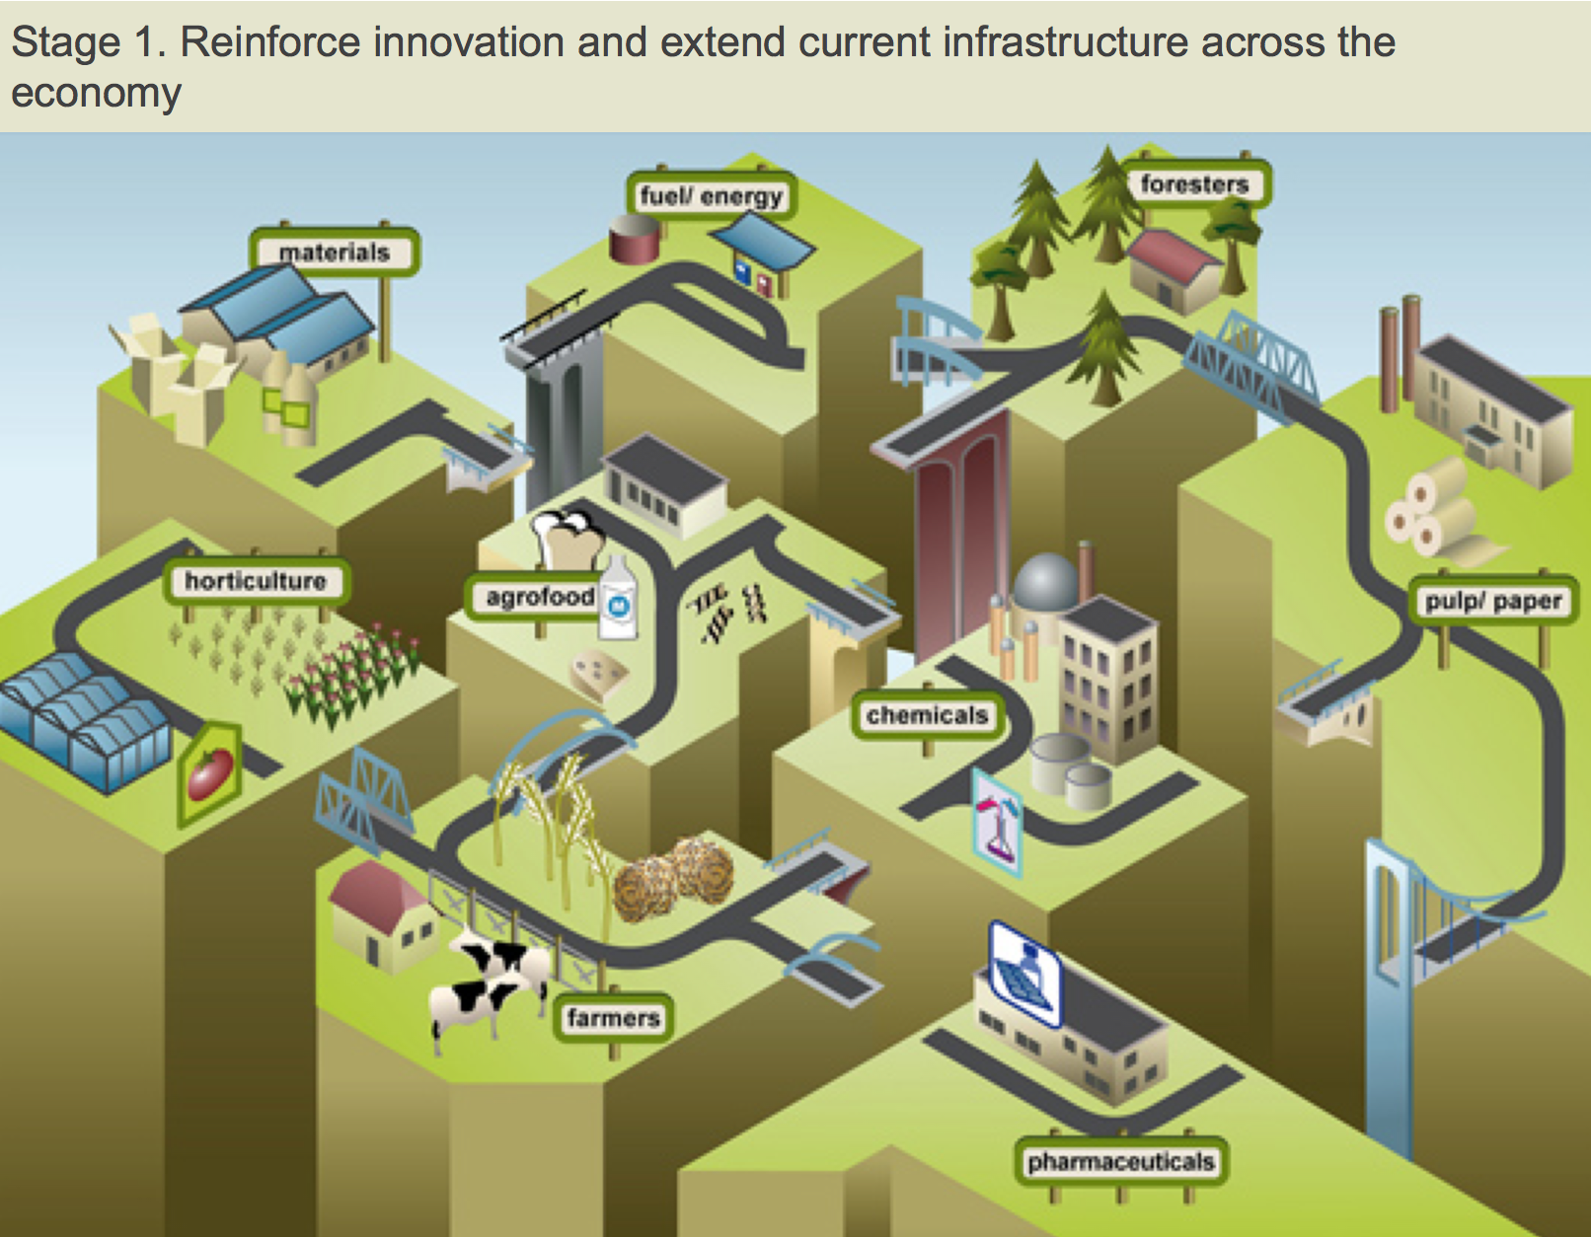
Source: BBI

Slide 3
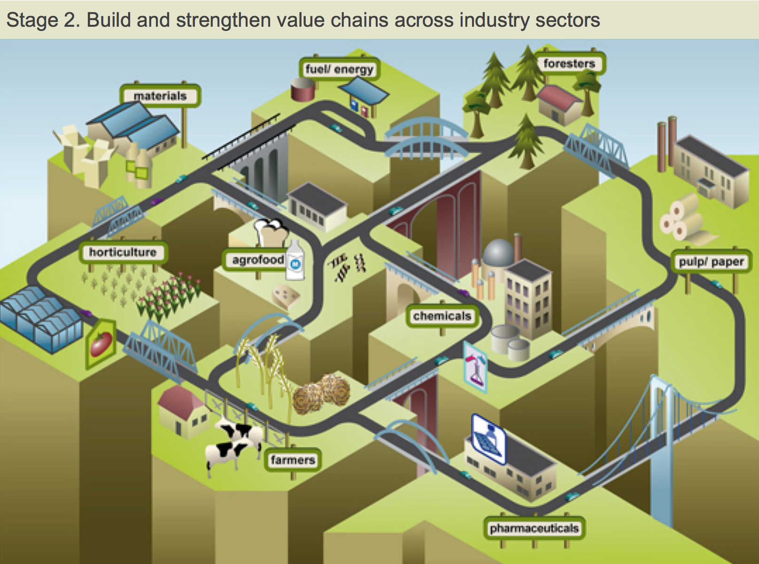
Source: BBI

Slide 4
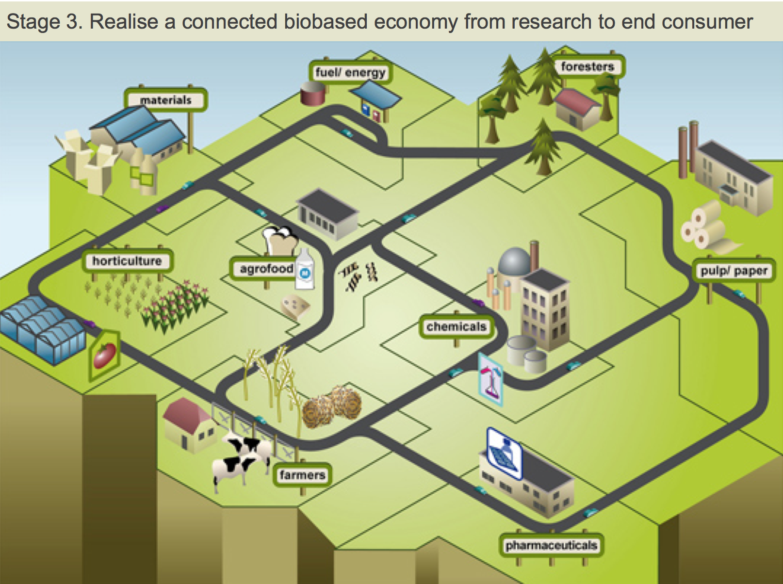
Source: BBI

Slide 6
Example for a marketable added value chain: BIOPLASTIC
RAW MATERIAL
MONOMER
RAW POLYMER
BLEND/ COMPOUND
SEMIFINISHED PARTS
INTERMEDIATES
PRODUCT
Fermentation
Co-/Polymeri-zation
Blending/ Compounding
Shaping
Refinement
Assembly
Purification

Slide 7
Example for a marketable added value chain: BIOPLASTIC
RAW MATERIAL
MONOMER
RAW POLYMER
BLEND/ COMPOUND
SEMIFINISHED PARTS
INTERMEDIATES
PRODUCT
Fermentation
Co-/Polymeri-zation
Blending/ Compounding
Shaping
Refinement
Assembly
Purification

Slide 8
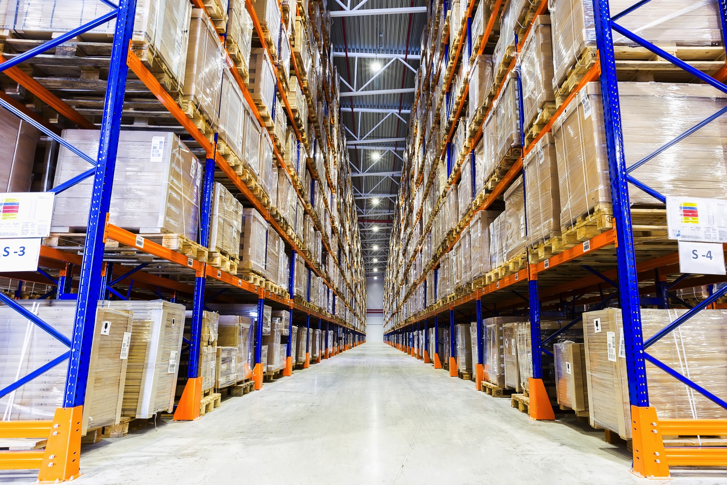
Suggested value added chain 1 for DanuBioValNet: ADVANCED-PACKAGING
© Petinovs / Fotolia
Est. increase from now 1.4 to 7.7 Mio t (2020)
Drop-in or new material properties
Bio-Plastic
Biodegradable & Bio-based nondegradable
Reaches in Every Market
Paper & Pulp

Slide 9
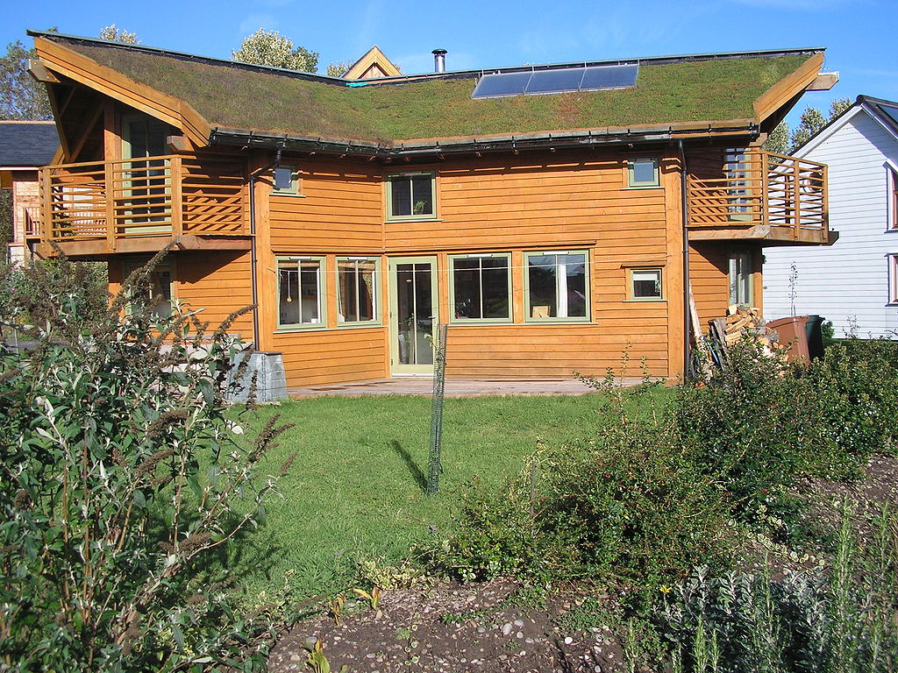
Suggested value added chain 2 for DanuBioValNet: ECO-CONSTRUCTION
© W.L Tarbert
Indoor Environmental Quality
Durable and Maintainable Design
Eco Friendly Material Use
Water Efficiency
Energy Efficiency
Waste Reduction

Slide 10
Suggested value added chain 3 for DanuBioValNet: PHYTO-PHARMACEUTICAL
© Bjoern Wylezich / Fotolia
1 or more active substances
Complex
cultivation
Rational, scientific data,
Clinical trial
Plant based
High
Value

Slide 11
Matching industry and consumer

Slide 12
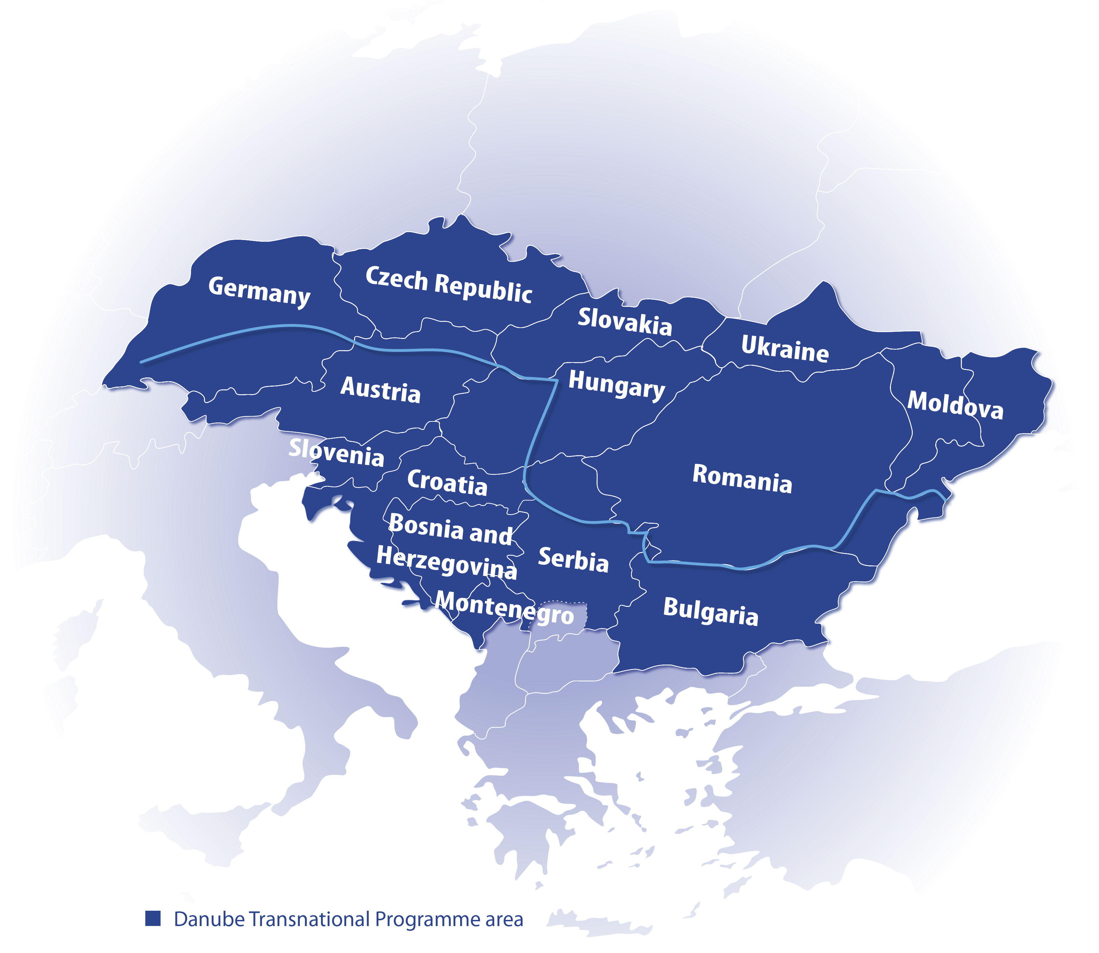
9 EU countries + 5 non-EU countries; 1/5 of EU‘s territory
114 million people

Slide 13
15 Project Partners + 2 Associated Partners
10 Countries
Germany
BIOPRO Baden-Württemberg GmbH
ClusterAgentur Baden-Württemberg
Czech Republic
National Cluster Association
Austria
Foodcluster OÖ
Cleantechcluster OÖ
Slovenia
Ministry of Science
Anteja ECG
Croatia
Ministry of Economy, Entrepreneurship and Crafts
Croatian Wood Cluster
Slovakia
Prounion
Romania
Ministry of Economy
Clustero
Institute of Economical Forecasting
Bulgaria
Association of Bulgarian Clusters
Serbia
Institute of Mechanical Engineering

Slide 14
15 Project Partners + 2 Associated Partners
10 Countries
Germany
BIOPRO Baden-Württemberg GmbH
ClusterAgentur Baden-Württemberg
Czech Republic
National Cluster Association
Austria
Foodcluster OÖ
Cleantechcluster OÖ
Slovenia
Ministry of Science
Anteja ECG
Croatia
Ministry of Economy, Entrepreneurship and Crafts
Croatian Wood Cluster
Slovakia
Prounion
Romania
Ministry of Economy
Clustero
Institute of Economical Forecasting
Bulgaria
Association of Bulgarian Clusters
Serbia
Institute of Mechanical Engineering
Montenegro
Vinecluster of Montenegro
Ministry of Economic Affairs, Labour & Housing Baden-Württemberg

Slide 15
Workflow of the DanuBioValNet project
Phase 1 - Data Survey
Phase 2 – Establishing bio-based networks

Slide 16
DanuBioValNet is groundbreaking for further projects
Further projects based on DanuBioValNet‘s activities will strengthen and secure dissemination of the bio-based industry; Funding schemes (Cosme, Horizon2020/FP9, regional development funds,...)

Slide 17
DanuBioValNet is groundbreaking for further projects

Slide 18
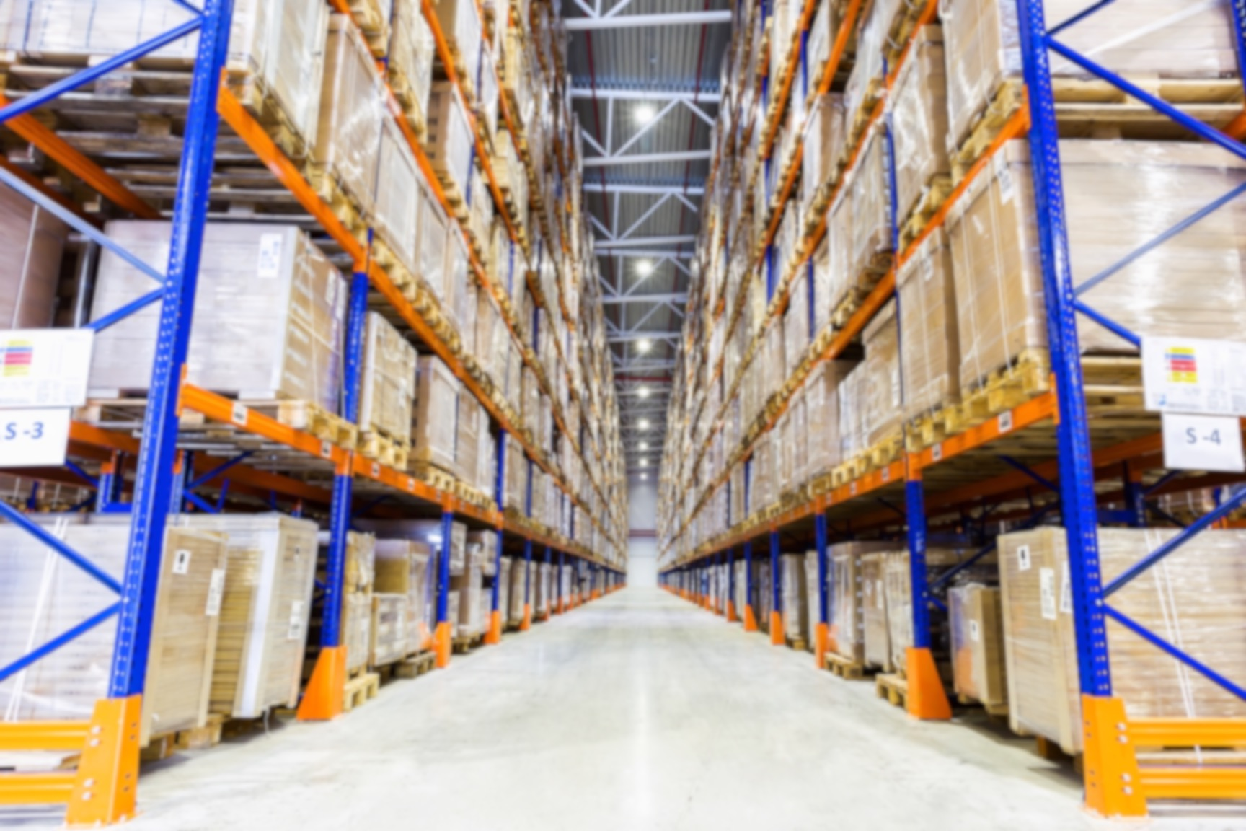
DanuBioValNet is groundbreaking for further projects

Slide 19
We believe in a shared value development
Because innovative product scenarios in Bioeconomy offer the chance to develop new business models on a regional, state-wide, country-wide and pan-European level
© Petinovs / Fotolia
© W.L Tarbert
© Bjoern Wylezich / Fotolia

Slide 20
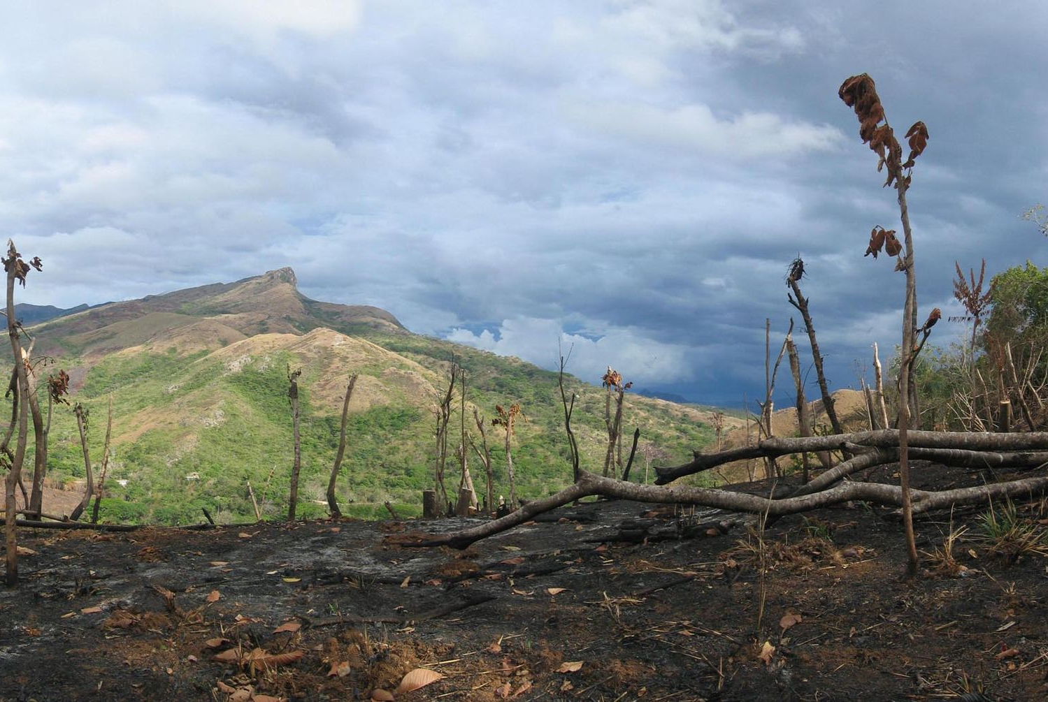
But there are also big threads!!!
Illegal forest clearance
Exaggerated intensification of monoculture crop growing
Destroying biodiversity by massive wild harvesting
© Dirk van der Made
© Kamiak Butte
© Cooper

Slide 21
We need to develop sustainable bioeconomic structures

